Slide 1


Slide 2

Did you know?

Slide 3

Did you know?
There are 8 times more atoms in a teaspoonful of water than there are teaspoonfuls of water in the Atlantic Ocean.

Slide 4
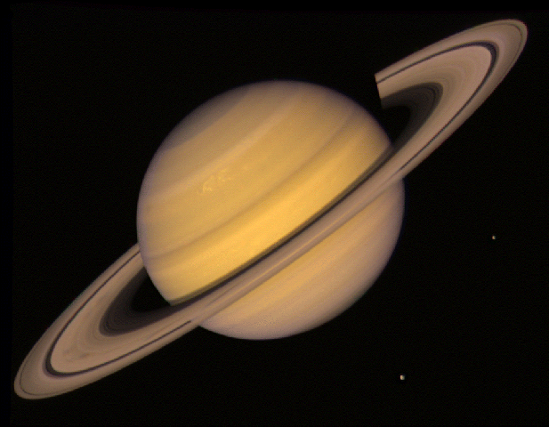
Did you Know?
Saturn is less dense than water. If you had a big enough pool of water, Saturn would float on it.

Slide 5
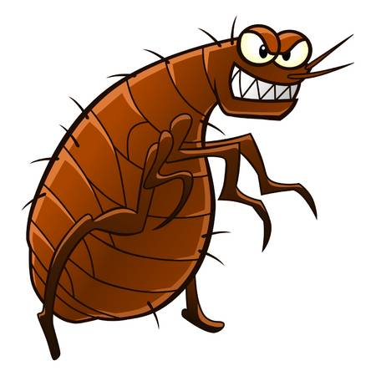
Did You Know?
Fleas can jump over 80 times their own height. That is the same as a 6 foot tall human jumping 480 feet high.

Slide 6

Prize Puzzles
Over this week there will be 5 Puzzles on the walls of the school.
Pay attention to the questions, solve them and record.
On Friday submit your entries by email to siobhan.okeeffe@lcc.cdetb.ie

Slide 7
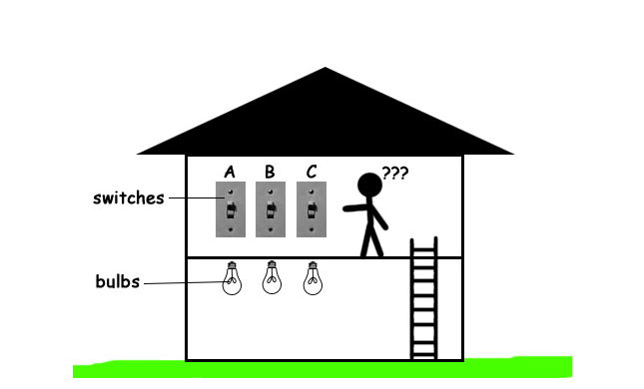
Monday prize riddle
You need to match the 3 switches on the first floor to the bulbs on the ground floor.
You cannot see one room from the other.
You are only allowed to check the bulbs once and you must flick the switches yourself.
How can you do it?

Slide 8
Tuesday Prize Puzzle
When Roderick was six years old he hammered a nail into his favourite tree to mark his height.
Five years later at age eleven, Roderick returned to see how much higher the nail was.
If the tree grew by ten inches each year, how much higher would the nail be?

Slide 9
Wednesday’s prize riddle
A window cleaner is cleaning the windows on the 25th floor of a skyscraper. He slips and falls. He is not wearing a safety harness and nothing slows his fall, yet he suffers no injuries. Explain.

Slide 10
Thursday’s prize riddle
A woman lives on the tenth floor of a block of flats. Every morning, she takes the lift down to the ground floor and goes to work. In the evening, she gets into the lift, and, if there is someone else in the lift, she goes back to her floor directly. Otherwise, she goes to the eighth floor and walks up two flights of stairs to her flat. How do you explain this?

Slide 11
Friday’s prize riddle
A man builds a rectangular house, each side having a southern view. He spots a bear. What colour is the bear?

